Slide 1
HACK THE NIGHT Government College of Engineering, Kannur
Farha Kareem
Twitter:@farhakareem
GitHub:farhakareem

Slide 2
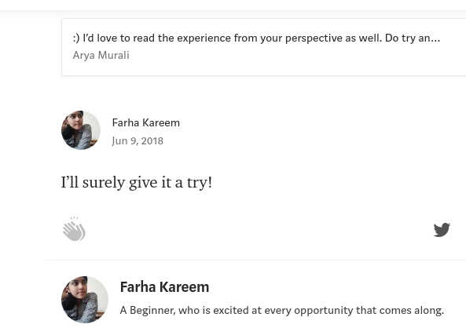
Step 1: Opportunity Hackathon- conducted by Pehia. Met Arya Murali.
Writes the first blog.

Slide 3
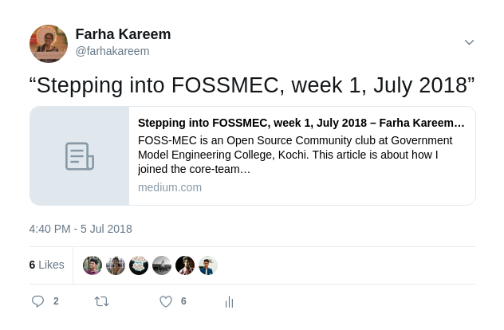
Joined FOSSMEC-
An open source community club.

Slide 4

Kerala Flood conditions.
Developed Helpline Kerala.
Wrote a blog- got published in FCC.

Slide 5
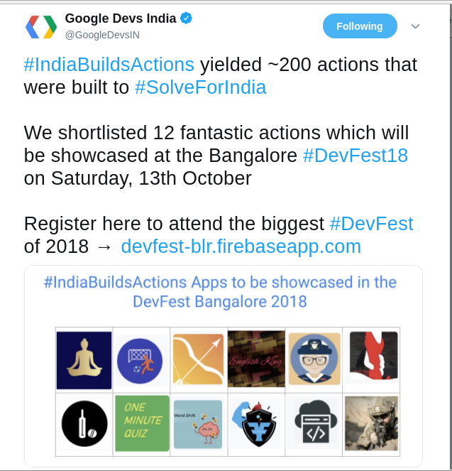
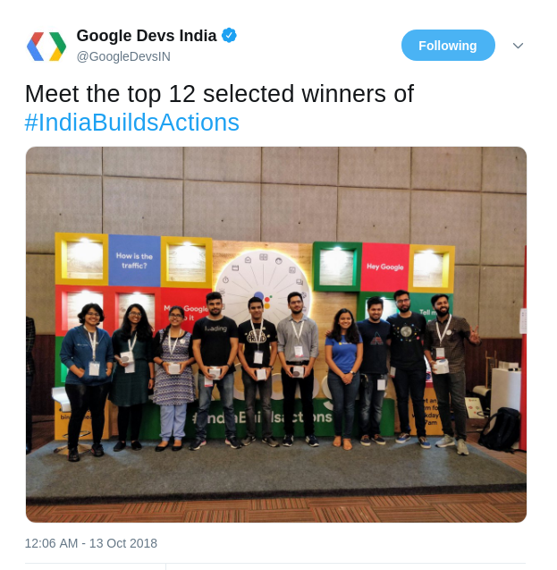
Won #BuildforIndia competition by Google

Slide 6
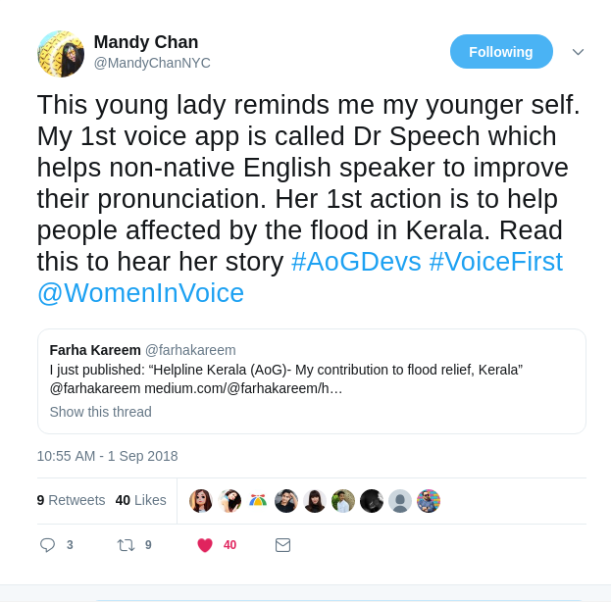
Mandy Chan
tweeted me out!
Developer Community Manager-AoG
Built a relationship with her.

Slide 7
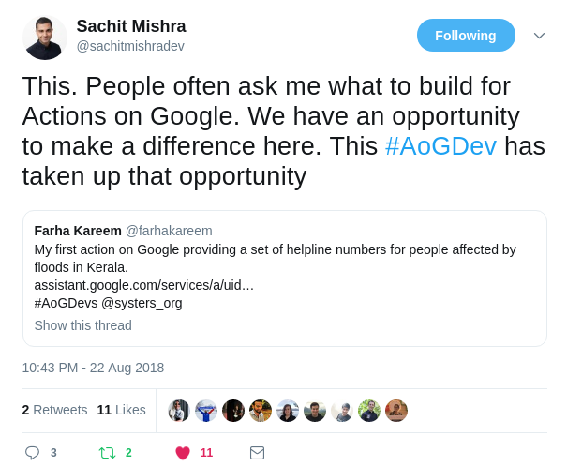
Sachit Mishra tweeted me out as well.
Developer Programs Engineer at Google.

Slide 8
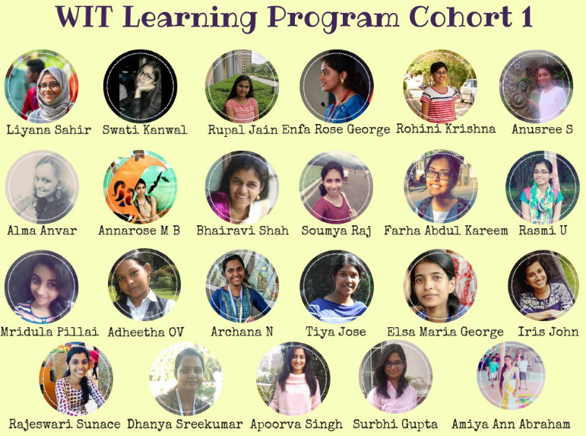
WIT Learning Program-Rethink
Discover
Build
Connect
Apply

Slide 9
Met Ayushi- mentor.
Wider perspective.

Slide 10
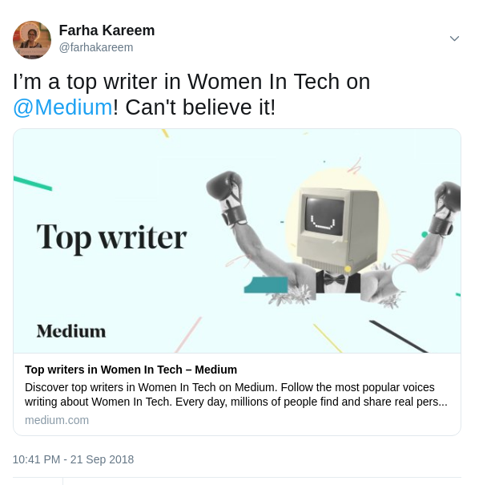
Top Writer in Women in Tech
After all the TWTWs

Slide 11
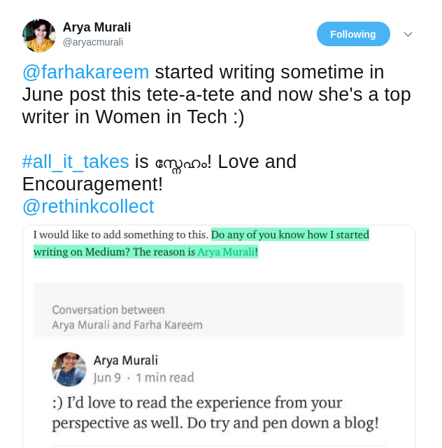
Arya’s tweet
Make people look good and feel good.

Slide 12
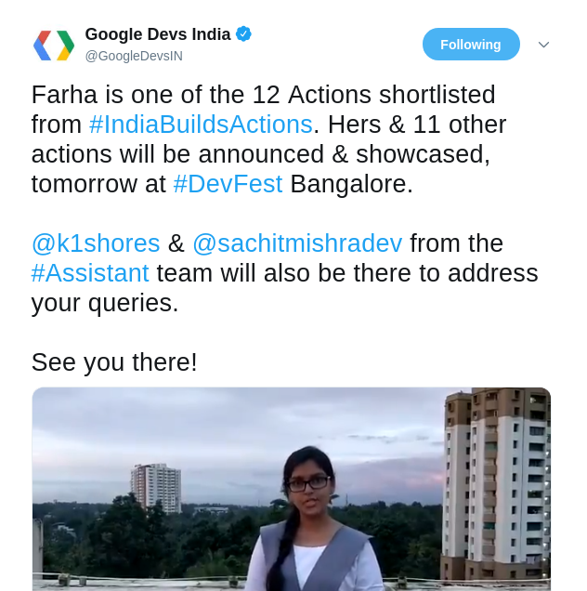
Google Developers India tweets me out!
Thanks to Arya for this opportunity!

Slide 13
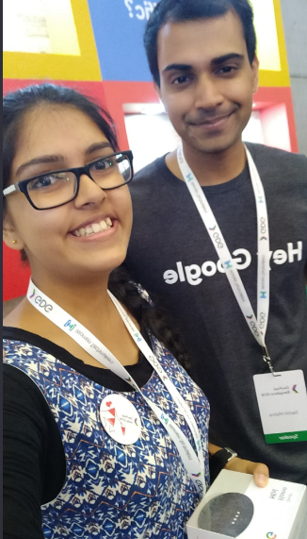
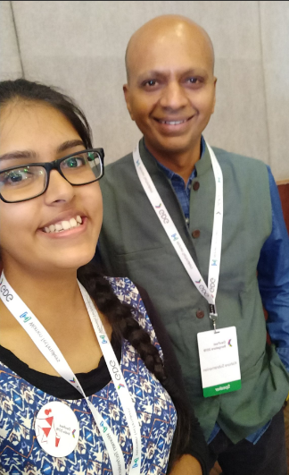
DevFest Bangalore- sponsored by Google
Met Sachit Mishra and Kishore Subramanian and Karthik Padman- All the way from Mountain View

Slide 14
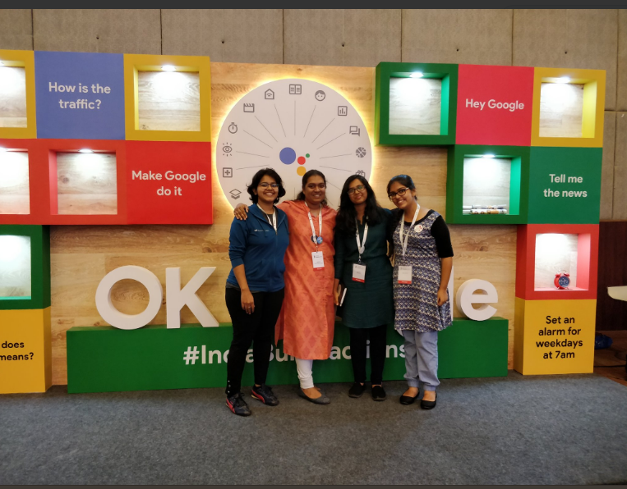
Met Lakshya, Program Coordinator, Women Techmakers, India

Slide 15
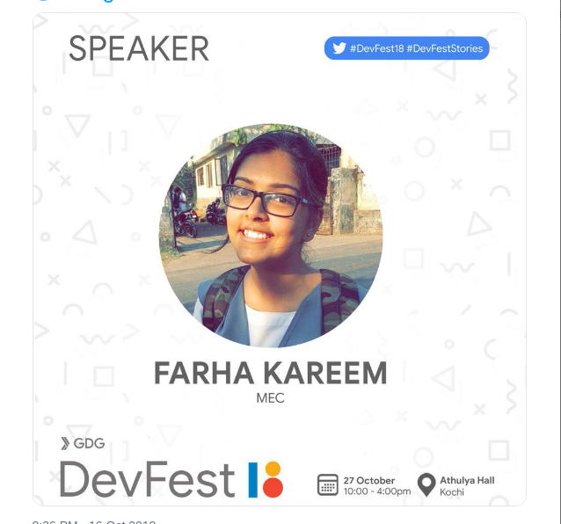
Speaker at Google DevFest Cochin 2018
An interactive session on Action on Google.

Slide 16
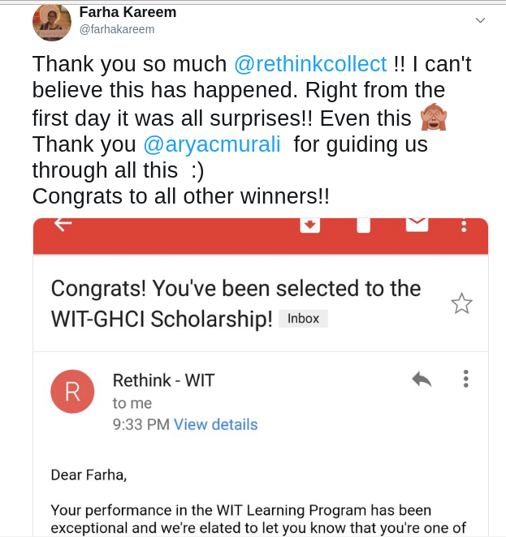
Won WIT-GHCI Scholarship

Slide 17
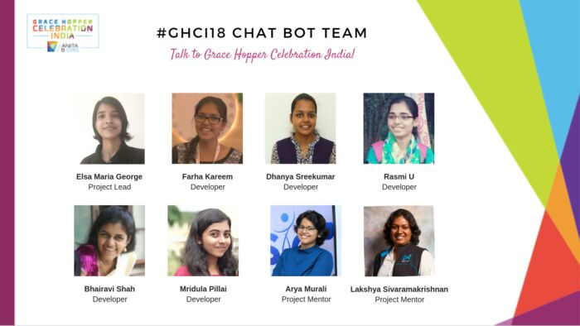
GHCI ChatBot

Slide 18
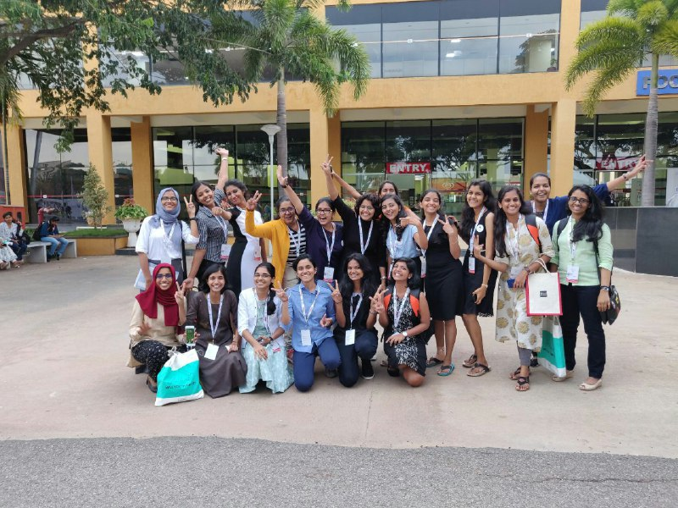
GHCI Finally!

Slide 19
Thank you!

